Slide 1
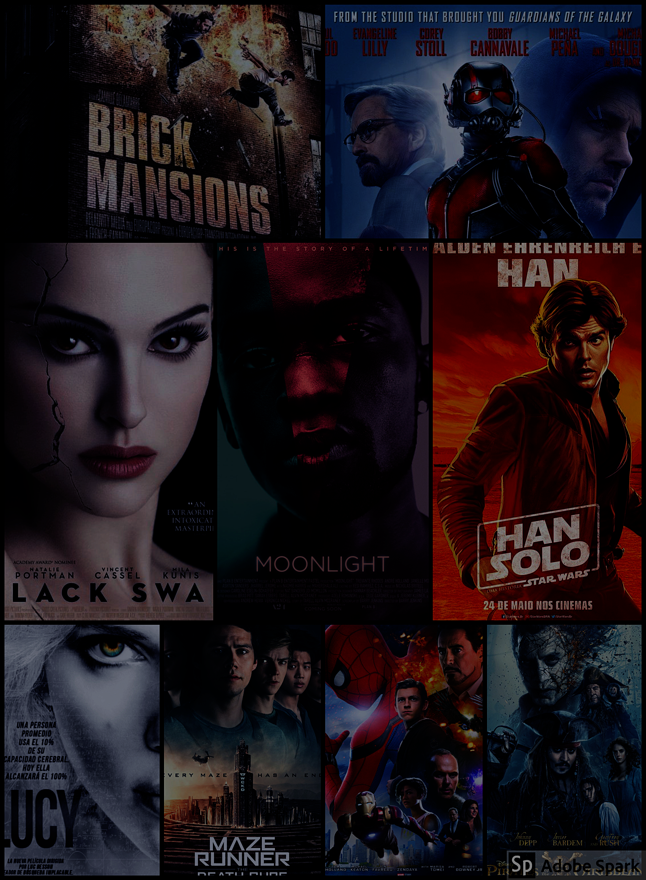
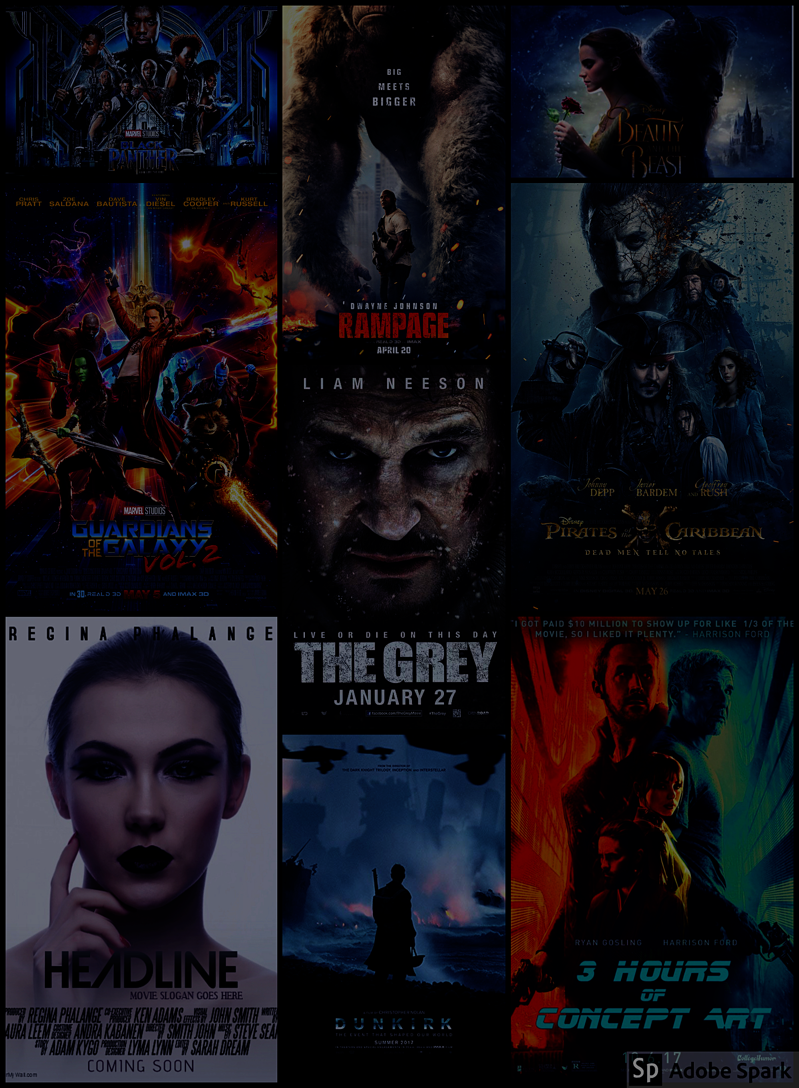
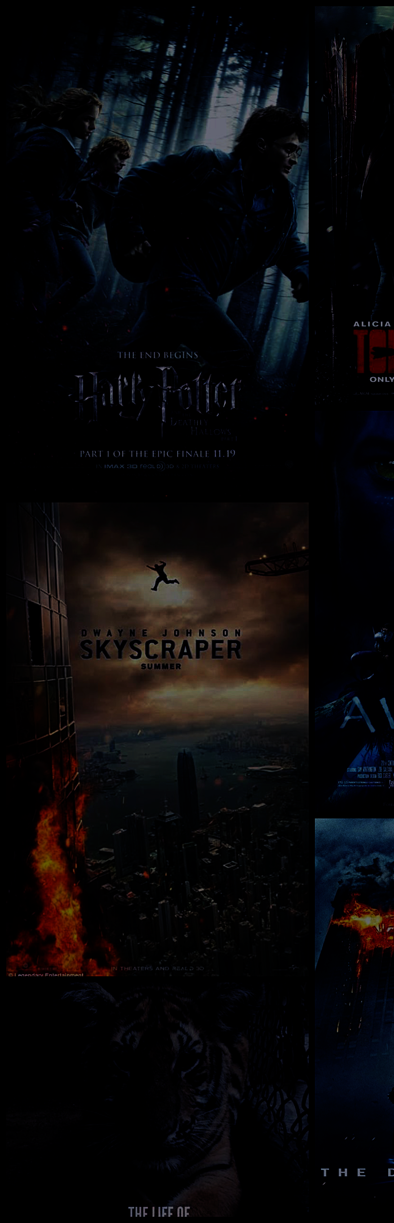
Forecasting Movie Revenue With Fusing Neural Network
Advanced Data Mining Lab
Advanced Data Mining & Application Laboratory
Advisor
Prof. Yi cheng chen and Tipajin Thaipisutikul (Ph.D. Candidate)
Group members
1. Ms. Waralee Tanaphantaruk
Ms. Supatsara Rodratsa
Ms. Pattararat Kiattipadungkul
Mr. Bundit Hou
Notes:
Hello we are from Advanced Data Mining Lab. Our advisors are Prof Yi cheng chen and Aj.Tipajin. My name is…..(Introduce members) First let’s see our introduction trailer.

Slide 2
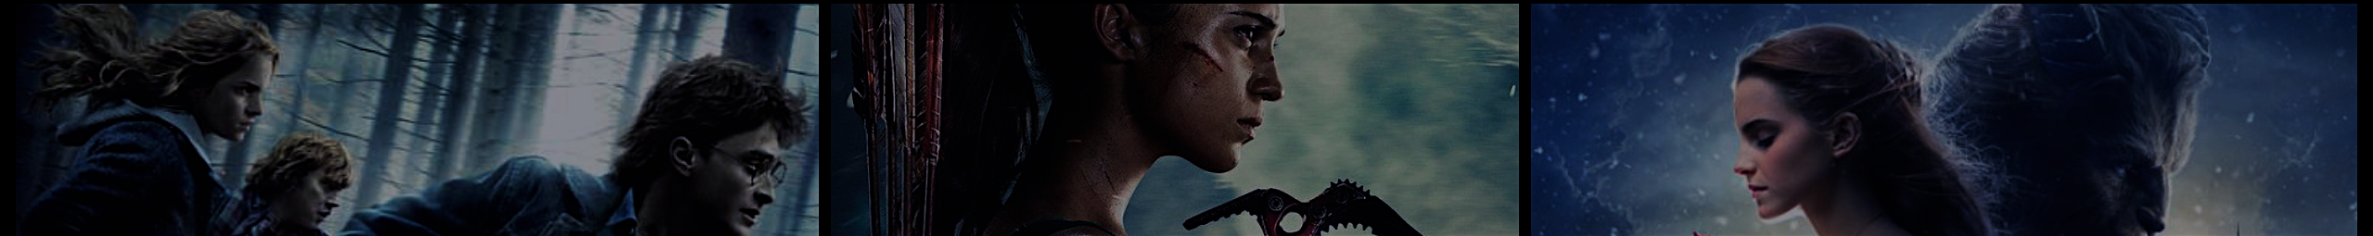


Slide 3


Motivation
Related Work
Dataset
Data Preprocessing
Methodology
Experimental Results
Conclusion and Suggestion
Notes:
Our topic is Forecasting movie revenue with fusing neural network. We will talk about our motivation, previous related work, dataset that we used, our data preprocessing, methodology, experimental result and conclusion about what we have done and studied.
Transition: First, let’s start with our motivation of our project.

Slide 4

Notes:
The video that I just show you is an official trailer from Mission Impossible 6: Fallout. This movie has just released today. If I say this movie is going to make revenue more than 128 million dollars, will you believe it? Let us prove our prediction is true.

Slide 5
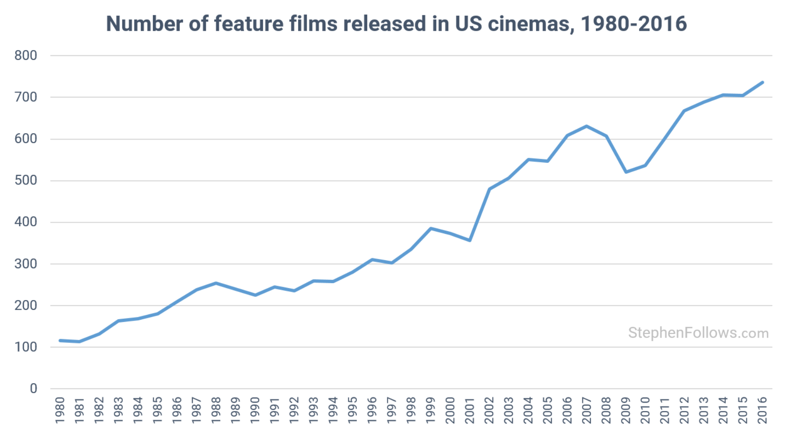
Motivation
Source: https://stephenfollows.com/how-many-films-are-released-each-year/
Notes:
As we know, nowadays, movie industry has grown continuously since the global entertainment market is expanding on multiple fronts as mentioned in www.mmpa.org, a motion picture association of America.
This graph shows the number of movies released in United state. It proves that the number of movies keep growing in recent years. However, not all of them can make profit and of course no one want to make loss. Hence, the purpose of this project is to predict estimated revenue of movie before movie is launched so that the movie producers are able to make a right decision on their work and marketing plan. In addition, they can also use this prediction to convince investors, sponsor, product placement or entertainment company.

Slide 6
Motivation
Related Work
Dataset
Data Preprocessing
Methodology
Experimental Results
Conclusion and Suggestion
Notes:
Now, you know the reasons why we are interested in doing this project. Next, let’s see what are previous related work that we have learned.

Slide 7
Related Work
Source: https://www.youtube.com
Source: https://trends.google.co.th/trends/
Notes:
There are many related works that we have found while doing this project. They use various type of inputs like historical data of movies. Only some of them use social media analysis. Moreover, they mostly classified output as success or not success, profit or loss. Hence, our work applied more data from google trend and YouTube comment sentiment analysis. We also defines the classification output as the movie revenue range and use regression approach as well.

Slide 8
Motivation
Related Work
Dataset
Data Preprocessing
Methodology
Experimental Results
Conclusion and Suggestion
Notes:
I’ve talked about the related work and how we are different from the others. Next is the dataset and data resource that we use.

Slide 9
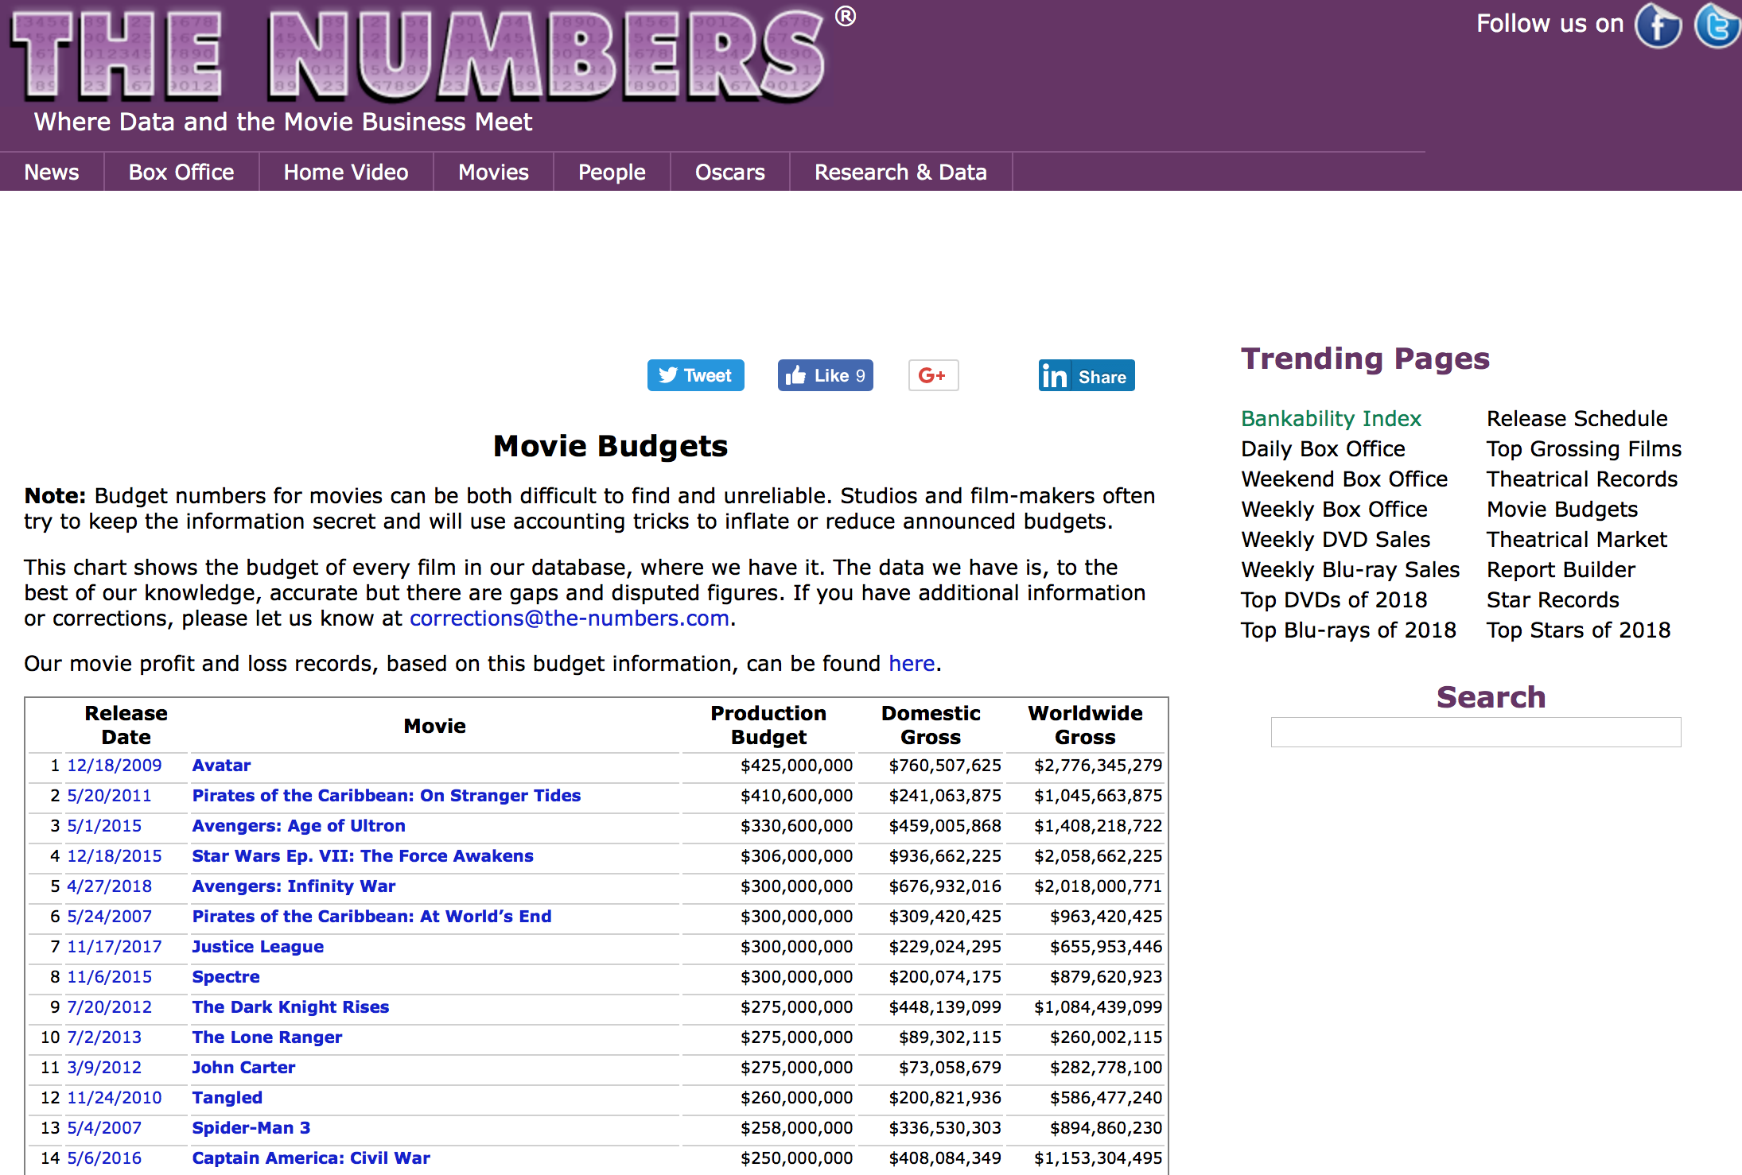
Dataset
Title
Budget (USD)
Total gross (USD)
Release Date
The-Numbers
Source: https://www.the-numbers.com
Notes:
At first, we scraped title, release date, budget, domestics gross and worldwide gross from the-numbers that released between 2012 and 2018.

Slide 10
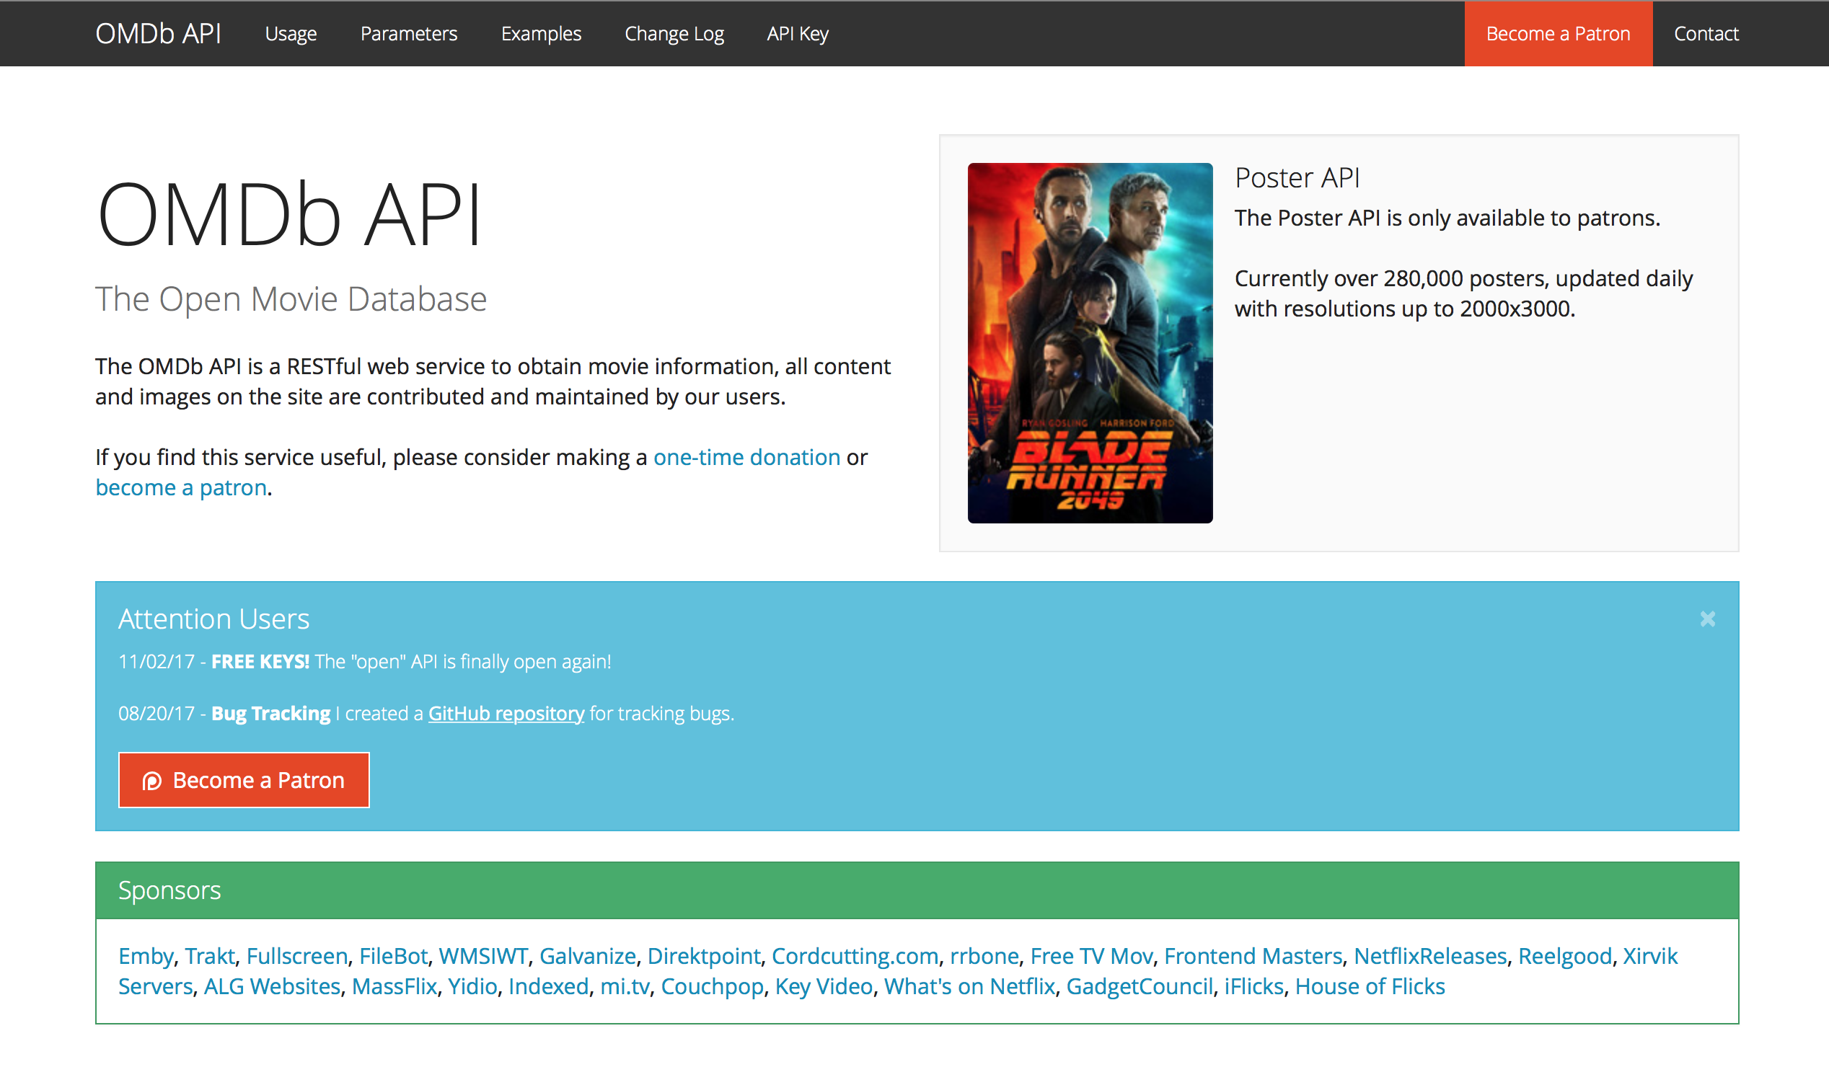
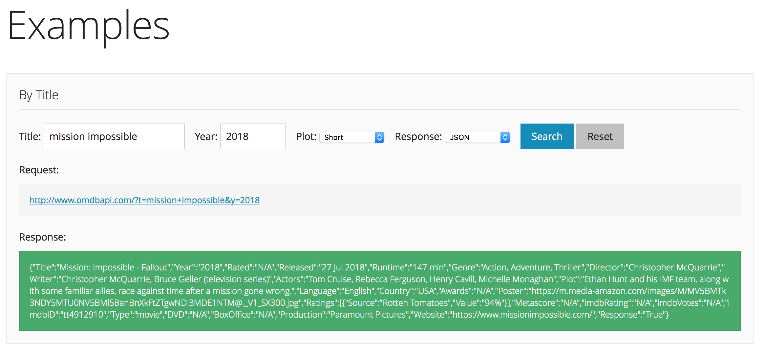
Dataset
Actors
Director
Production
Genre
Writer
IMDb rating
IMDB vote
OMDb API
Source: http://www.omdbapi.com
Notes:
Then we extracted actor, production, director, writer, genre, imdb rating and imdb vote from OMDb API by using omdb library that provided by python.

Slide 11
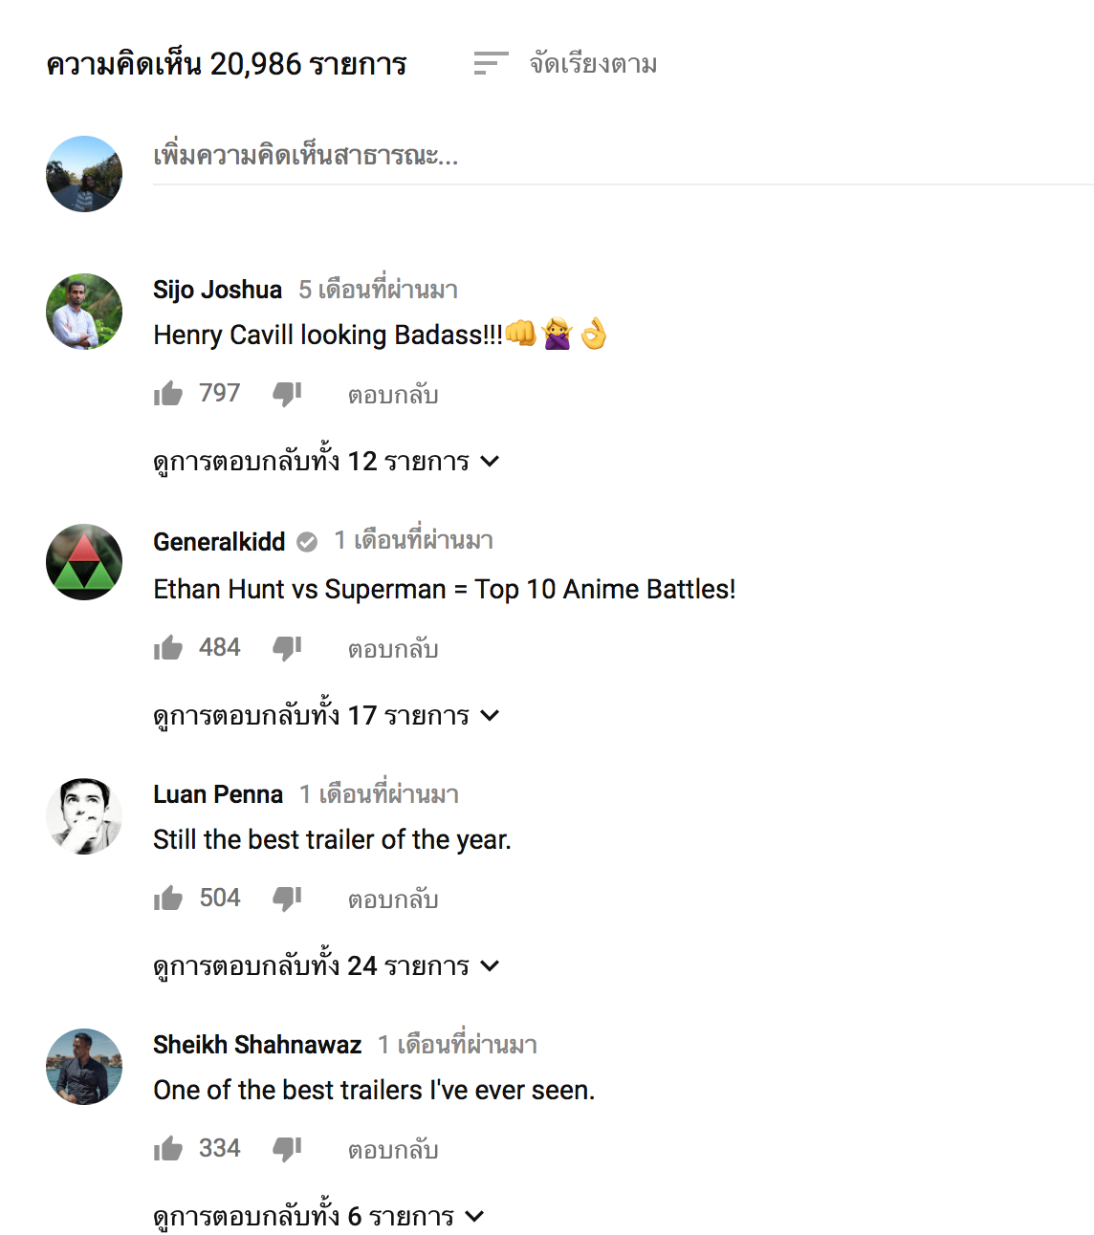
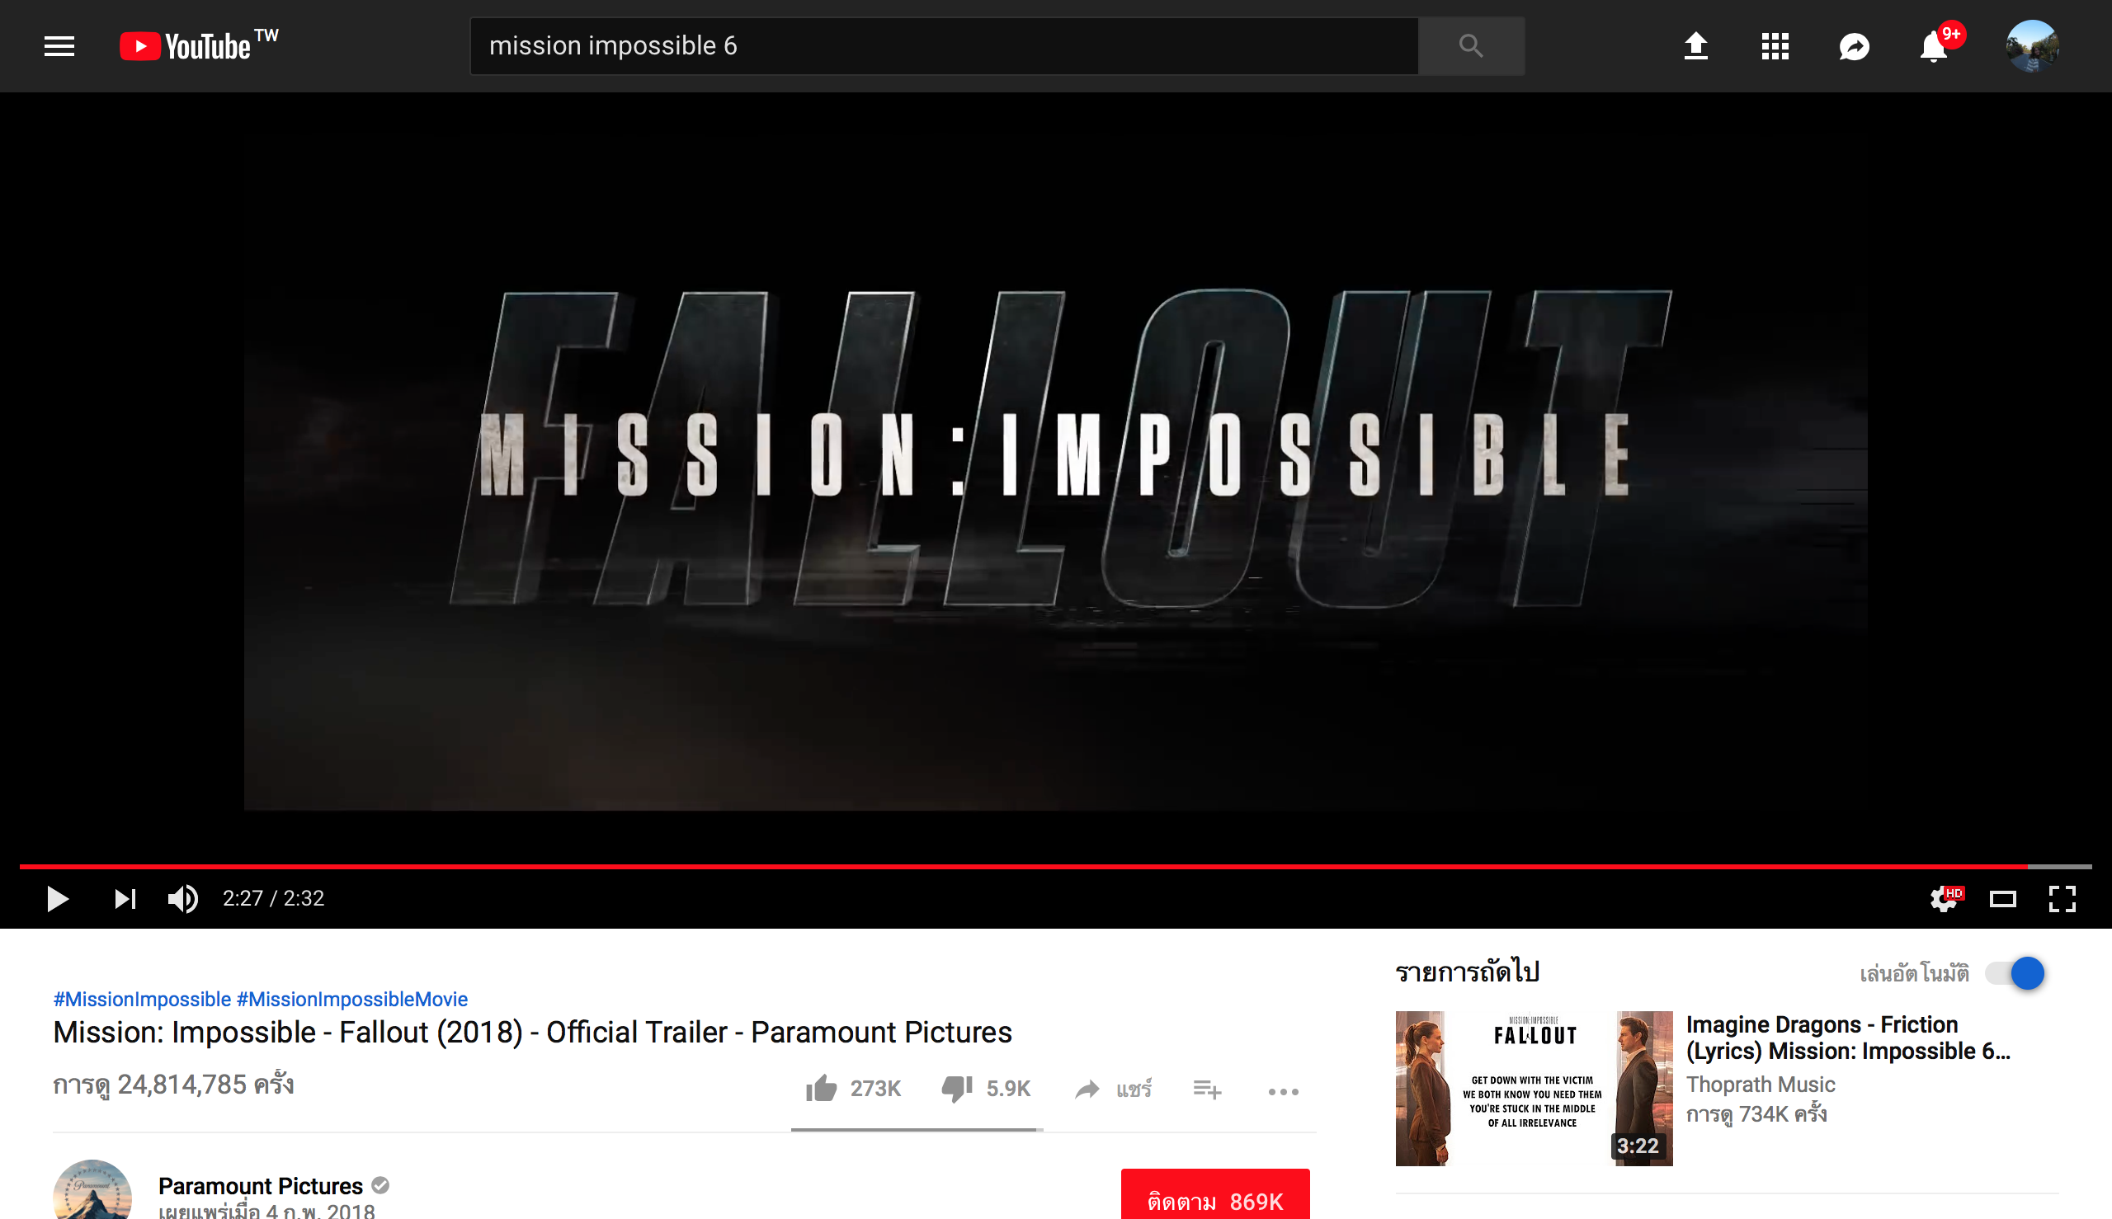
Dataset
View Count
Like Count
Dislike Count
Comment Count
Comments
Source: https://www.youtube.com
YouTube
Notes:
We also retrieved social media data. The dataset from YouTube contains view counts, like counts, dislike counts, comment counts and comments from official trailer.

Slide 12
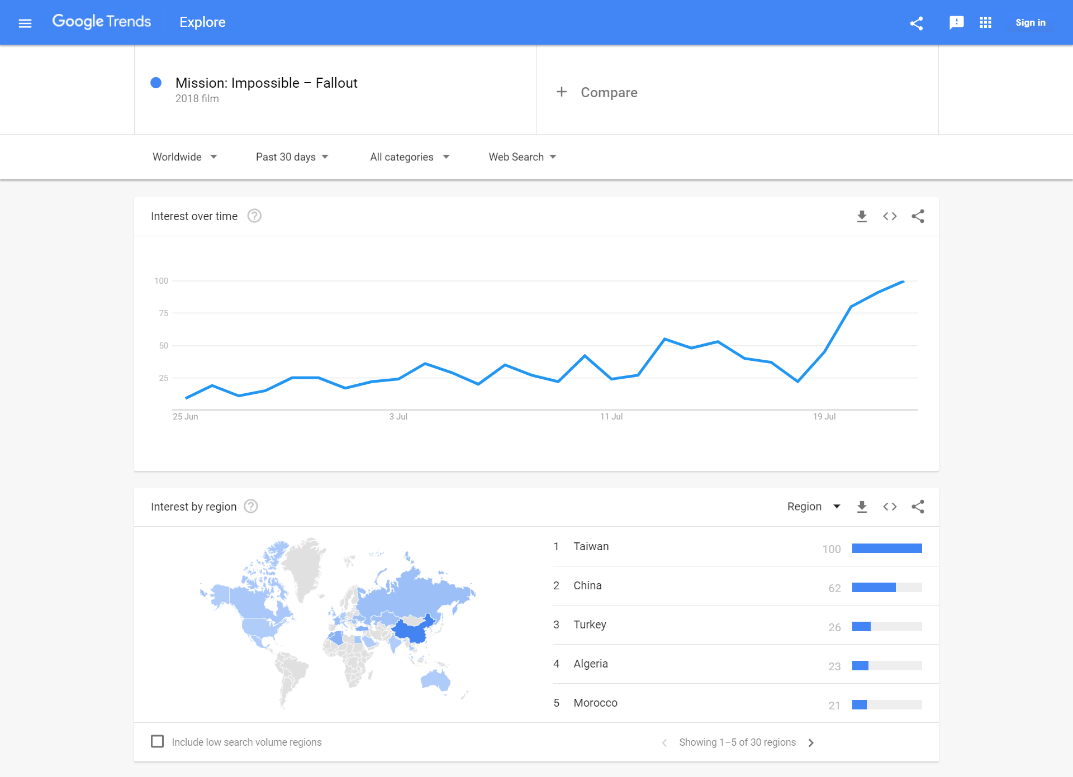
Dataset
Interested Score
Google Trend
Source: https://trends.google.co.th/trends/
Notes:
And the last dataset, we extracted from Google trend that contains interested score over 30 days before the movie is launched.

Slide 13
Motivation
Related Work
Dataset
Data Preprocessing
Methodology
Experimental Results
Conclusion and Suggestion
Notes:
That’s all about our dataset, next is our data preprocessing. The data we have right now is raw data. We cannot use them instantly. Hence, we need to do data preprocessing first.

Slide 14
Data Preprocessing
Data Cleaning
Uncompleted Data
Removed Outlier
913 Movies
Notes:
First, we need to clean data. Some movie names cannot search by OMDb API so we corrected them and searched again. However, some don’t have all data attributes in all sources so we remove them. Outliers and unnecessary attributes are also removed. The final number of movie in our dataset is 913 movies which have completed information.

Slide 15
Data Preprocessing
Data Transformation
Data Cleaning
Numerical Data
Non-Numerical Data
Budget (USD)
Total gross (USD)
View Count
Like Count
Dislike Count
Comment Count
Interested Score
Release Date
Actors
Director
Production
Genre
Comments
Notes:
After we cleaned data, we have completed raw data. There are two groups of data which are numerical data and non-numerical data.

Slide 16
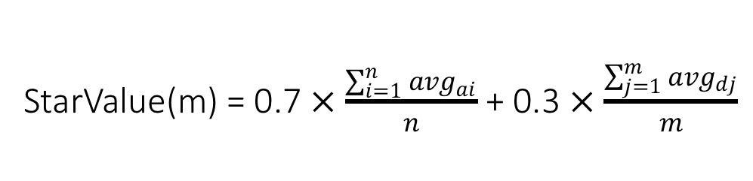
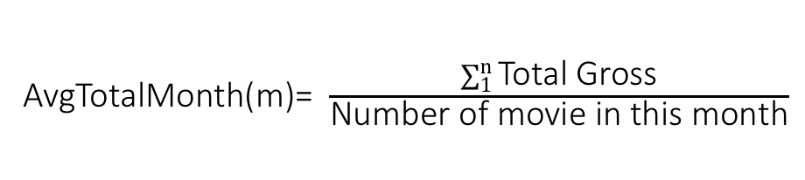
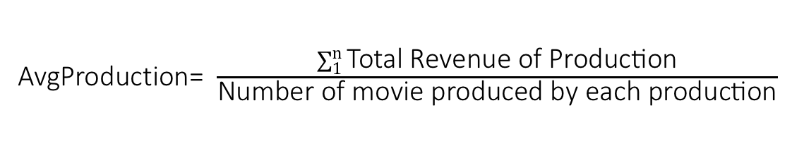
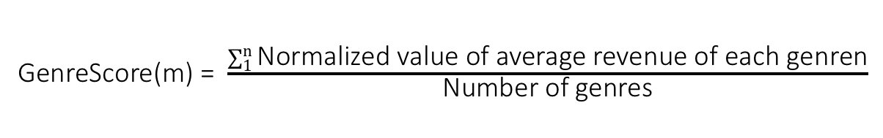
Data Preprocessing
StarValue(m) = 0.7 $×$ $\frac{\sum_{i=1}^{n}{{avg}_{ai}}}{n}$ + 0.3 $×$ $\frac{\sum_{j=1}^{m}{{avg}_{dj}}}{m}$
Actor
Star Power
Director
AvgTotalMonth(m)= $\frac{\sum_{1}^{n}{\text{Total} \text{Gross}}}{\text{Number} \text{of} \text{movie} \text{in} \text{this} \text{month}}$
Release Date
AvgTotalMonth
AvgProduction= $\frac{\sum_{1}^{n}{\text{Total} \text{Revenue} \text{of} \text{Production}}}{\text{Number} \text{of} \text{movie} \text{produced} \text{by} \text{each} \text{production}}$
Production
AvgProduction
GenreScore(m) = $\frac{\sum_{1}^{n}{\text{Normalized} \text{value} \text{of} \text{average} \text{revenue} \text{of} \text{each} \text{genren}}}{\text{Number} \text{of} \text{genres}}$
Genres
GenreScore
The basic pre-processing
Comments
Textblob library
SentimentScore
Advance text processing
Notes:
Non-numerical data cannot be used as input instantly so we need to convert them to be the numerical data first as you can see at the right.

Slide 17
Data Preprocessing
Class Of Total Gross
 | Range
Class 1 | 0 – 10 M
Class 2 | 10 – 48 M
Class 3 | 48 – 128 M
Class 4 | > 128 M
Notes:
Then we classified the total gross of the datasets without outliers into four classes by using quartile. The ranges of each class are 0 - 10 M, 10-48 M, 48-128 M and more than 128 M. We used these classes as the outputs of the train and test datasets for training the classification model.

Slide 18
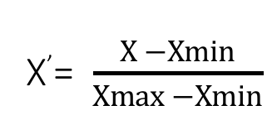
Data Preprocessing
Normalization
X’= $\frac{X −Xmin}{\operatorname{Xmax}{−}Xmin}$
where
X = the actual value of a variable Xmin = the minimum of all the values
Xmax = the maximum of all the values X’ = the normalized values in the range of [0, 1]
Input for normalization
Budget
Total gross
Star power
Average production
Average total gross of each month
View Count
Like Count
Dislike Count
Comment Count
Notes:
After all data are numerical values, we normalized them because the range is very large.

Slide 19
Data Summary
913 Movies | Min | Max | Average
Budget | 50,000 | 275,000,000 | 28,615,052.48
Total Gross | 1,632 | 428,123,608 | 78,851,145.19
913 Movies | Profit | Loss
#Movies | 659 | 254
Notes:
Here is the final dataset after data preprocessing. The total movies is 913. 659 movies are profit and 254 movies are loss.

Slide 20
Motivation
Related Work
Dataset
Data Preprocessing
Methodology
Experimental Results
Conclusion and Suggestion
Notes:
Now that we have talked about data cleaning, data transformation and normalization. Next, we will discuss about methodology or our approach to predict movie revenue.

Slide 21
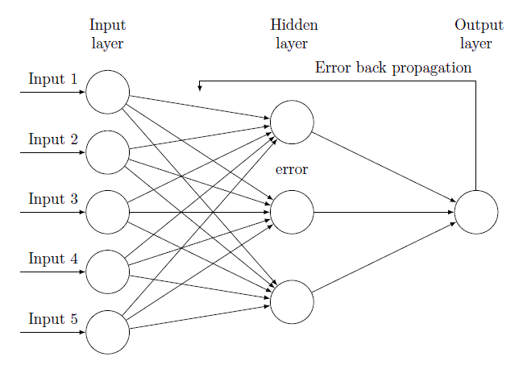
Methodology
The Back-propagation Neural Network Model
Source: https://tex.stackexchange.com/questions/162326/drawing-back-propagation-neural-network
Notes:
We used back-propagation neural network, an algorithm of multi layer neural nets to predict movie revenue. This model is using Keras, a python API. The back-propagation model generally consists of three layers; an input layer, a hidden layer, and an output layer. Each layer consists of neurons which are connected to the neurons in the previous and flowing layers by connection weights. These weights are adjusted by adding the error value called bias from the previous round. The learning process takes the inputs and the desired outputs, so the calculated output get as close as possible from the desired output according to its past training experience. That’s why machine learning is sometimes called model fitting.

Slide 22
Methodology
2 Approaches
Classification
Regression
 | Range
Class 1 | 0 – 10 M
Class 2 | 10 – 48 M
Class 3 | 48 – 128 M
Class 4 | > 128 M
Notes:
We use two approaches to predict movie revenue. The first one is Classification Predictive Modeling. This approach predicts discrete classes of movie revenue which have 4 classes as we mentioned before. Another approach is Regression Predictive Modeling. The approach predict a continuous quantity output which is normalized total gross.
According to what we mentioned before, we retrieved social media data to use as input as well. However, we found some problem. It is hard to get correct and clean data from social media since there are so many of them. Hence, we decided to do 2 experiments.

Slide 23
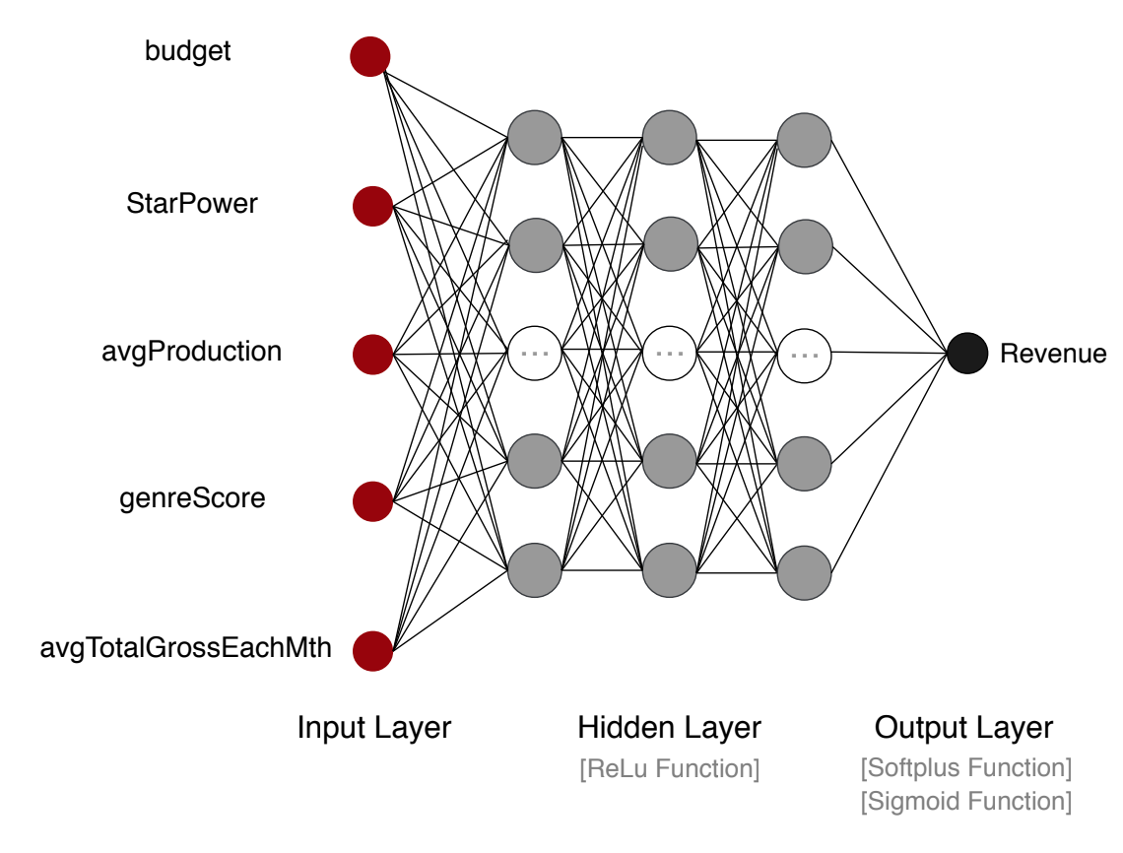
Methodology
The First Experiment
913 Movies
5 Inputs From Metadata
3 Hidden Layers
Notes:
The first experiment, we use all dataset (913 movies) without using social media data to learn how to use back-propagation neural network to predict revenue.
About model architecture. Input layer has 5 inputs. There are 3 layers in hidden layer. Each layer has 64,32 and 16 neurons respectively as shown in this figure. The output layer has only 1 neuron. All hidden layer use ReLu activation function. Activation function in output layer is different depends on the approach method. For regression, we used sigmoid function. For classification, we use softplus function.

Slide 24
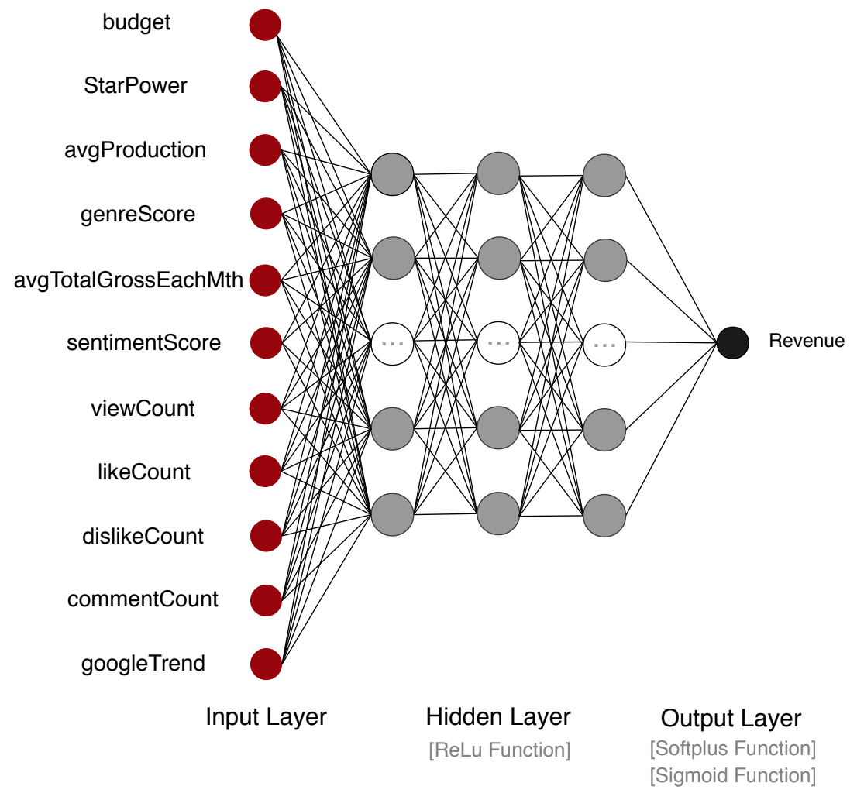
Methodology
The Second Experiment
100 Movies Sample
With Social Media
Without Social Media
11 Inputs From Metadata
3 Hidden Layers
Notes:
The second experiment, we selected and tested only 100 movies with and without using social media data. In this experiment, we focus on comparing their performance to see the influence of social media data on prediction performance. Our assumption is that with social media data, the accuracy of prediction increase.
The model architecture of this experiment is similar to model in first experiment except input layer, it has 11 neurons.

Slide 25
Motivation
Related Work
Dataset
Data Preprocessing
Methodology
Experimental Results
Conclusion and Suggestion
Notes:
That’s all for our methodology. Next, let me talk about the experiment results.

Slide 26
Experimental Results
Cross Validation
Source: https://www.kaggle.com/dansbecker/cross-validation
Notes:
We evaluated the performance of the model used in prediction by cross validation. We use 80% of movies in dataset to train model and the rest 20% for test performance. By using cross validation, it randomly splits dataset into train and test set. We do cross validation for 10 times and calculate average accuracy to evaluate the classification model. But for regression, we randomly splits dataset and evaluate performance by MSE and correlation value which measures the strength of a linear relationship between two variables on a scatter plot.

Slide 27
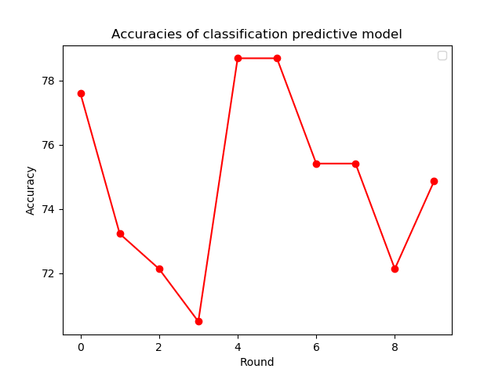
Experimental Results
The First Experiment: Classification predictive model
913 Movies
Accuracies Of Classification Predictive Model
The average accuracy is 74.86% (+/- 2.72%)
Notes:
For first experiment, which is testing model with 913 movies without using social media data, This graph shows the accuracy in each round from using classification predictive modeling.
According to this graph, the accuracies are inconstant. The reason is that train and test dataset were change every round which can result in higher or lower accuracy.

Slide 28
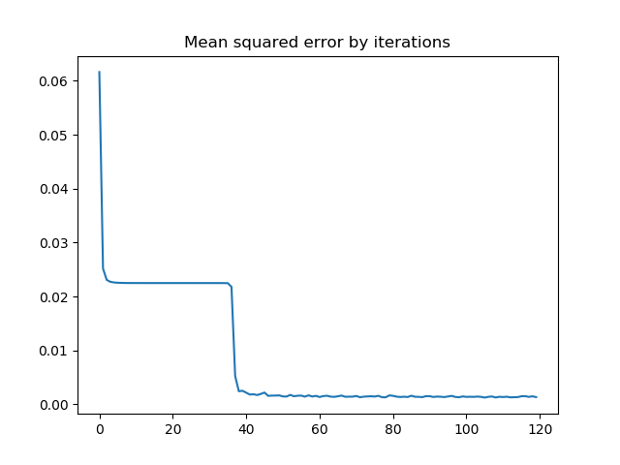
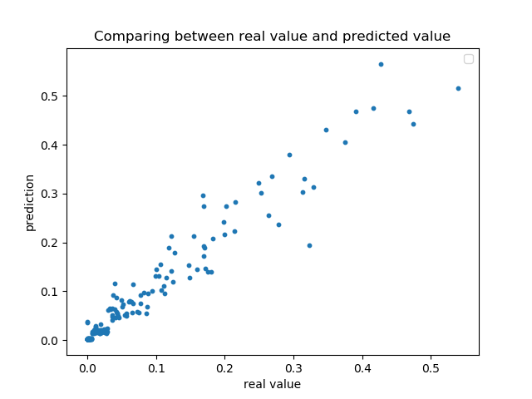
Experimental Results
The First Experiment: Regression predictive model
913 Movies
Mean Squared Error By Iterations
Comparing Between Real Value And Predicted Value
The final MSE is 0.00097
The correlation value is 0.94
Notes:
Here is the MSE result from regression predictive model.
The correlation value is close to 1 which means there is strong relation between real values and predicted values.

Slide 29
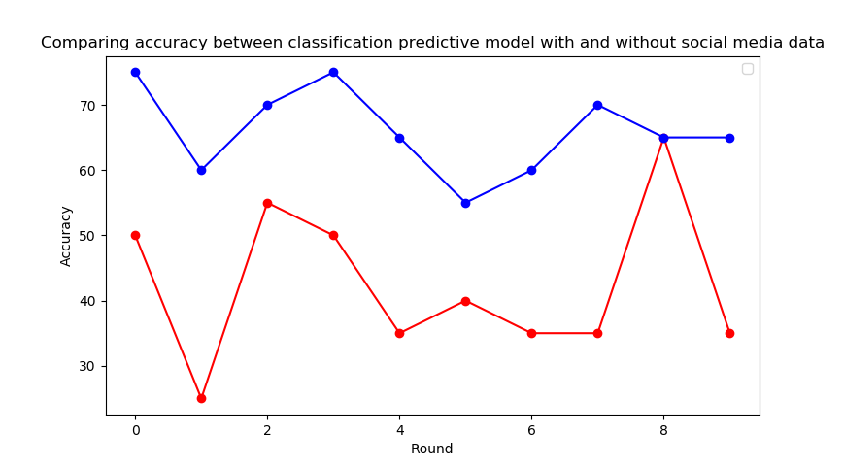
Experimental Results
The Second Experiment: Classification predictive model
100 Movies Sample
Compare Accuracy Between Classification Predictive Model With and Without Social Media
The average accuracy without social media is 42.50% (+/- 11.46%)
The average accuracy with social media is 66.00% (+/- 6.24%)
Notes:
The second experiment we use only 100 movie samples and test by using social media data to see the its influence on prediction. Here is the result.
The graph displays comparing accuracy between classification predictive model with and without social media data. We can see that with social media data showing by blue line, the accuracies are higher than the red line.

Slide 30
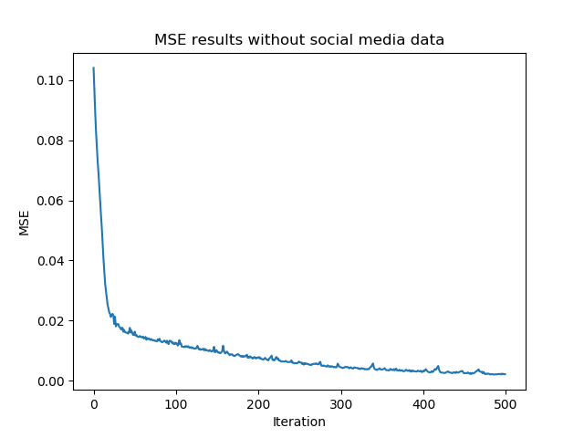
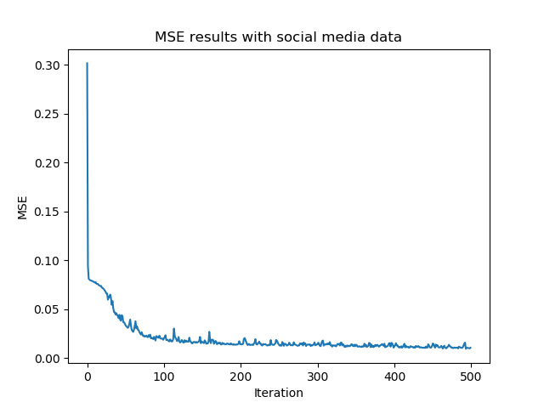
Experimental Results
The Second Experiment: Regression predictive model
100 Movies Sample
Mean Square Error Result Without Social Media Data
Mean Square Error Result With Social Media Data
The final MSE is 0.041
The final MSE is 0.022
The correlation value is 0.58
The correlation value is 0.77
Notes:
Moreover, if we look at regression result which define by MSE. Here are the graph shows the level of MSE by iterations comparing between using and not using social media data.
According to the final result on the slide, we can see that MSE from prediction with social media data is lower and correlation value is much higher.
Hence, we can conclude that using social media data increase model performance. However, there is very low chance that using social media data can give lower accuracy and higher MSE. It depends on our test and train dataset.

Slide 31
Motivation
Related Work
Dataset
Data Preprocessing
Methodology
Experimental Results
Conclusion and Suggestion
Notes:
That’s all for result of our experiment. Let’s conclude what we have talked about today.
In conclusion, in this project, we studied how to forecasting movie revenue using back-propagation neural network techniques. We also learned how to get data from various resources by many methods such as scraping from website and using available API. Then, we did data preprocessing by cleaning, transforming and normalizing them. Finally, we have 913 movies in dataset. Then we did 2 experiments by 2 approaches which are regression and classification. We use cross validation to evaluate classification model. The accuracy from the first experiment is more than 70% while MSE result from regression is around 0.001. From the second experiment, we can conclude that with social media data, the prediction performance is better. However, we only test with small group of data and small amount of input, so prediction is not very precise. For future work we would like to improve prediction performance to be better by using larger dataset and more inputs including social media data.

Slide 32
Thank you for your attention
Advanced Data Mining & Application Laboratory
Notes:
Finally, we have learned many things during this two months. We would like to thank you Prof. Timothy K. Shih and Aj. Pattanasuk for this great opportunity. Thank you Prof. Yi-Cheng Chen, Aj. Thip and all professors for your guidance and supervision during our summer internship. Thank you P’ Por, P’ Tle and everyone for taking care of us from the start. We greatly value your kindness and the time you dedicated to mentor us. Thank you.

